Slide 1
RATHINAM
CENTRE OF EXCELLENCE
Database Management System
Constraints in Relational DB
by
Mrs.B. Sharmila
Technical Trainer

Slide 2
Introduction to constraints
Constraints → Conditions for data in database
checked before performing any operation in database
(i.e., insertion, deletion and updates).
Operations will not be performed.
These conditions are called Relational Integrity constraints.
Constraints in Relational DB
Notes:
While designing Relational Model, we define some conditions which must hold for data present in database are called Constraints.
If there is a violation in any of constrains, operation will fail.
Relational Integrity Constraints – Relational Correctness Conditions.

Slide 3
Types of constraints
Domain Integrity constraints
Entity integrity constraints
Referential Integrity Constraints
Key Constraints
Constraints in Relational DB
Notes:
While designing Relational Model, we define some conditions which must hold for data present in database are called Constraints.
If there is a violation in any of constrains, operation will fail.
Relational Integrity Constraints – Relational Correctness Conditions.

Slide 4
Domain Integrity Constraints
These are attribute level constraints.
An attribute can only take values which lie inside the domain range.
e.g, ; If a constrains AGE>0 and AGE < 50 is applied on STUDENT relation, inserting negative value of AGE will result in failure.
ROLL_NO | NAME | ADDRESS | PHONE | AGE
1 | RAM | DELHI | 9455123451 | 18
2 | RAMESH | GURGAON | 9652431543 | 53
3 | SUJIT | CHENNAI | 9156253131 | 20
4 | SURESH | HYDERABAD | 9442951245 | -1
ROLL_NO | NAME | ADDRESS | PHONE | AGE
1 | RAM | DELHI | 9455123451 | 18
2 | RAMESH | GURGAON | 9652431543 | 53
3 | SUJIT | CHENNAI | 9156253131 | 20
4 | SURESH | HYDERABAD | 9442951245 | -1
Domain Constraint can be enforced by Check Constraints and Datatypes.
Constraints in Relational DB

Slide 5
Referential Integrity Constraints
When one attribute of a relation can only take values from other attribute of same relation or any other relation, it is called Referential Integrity.
Student
Department
ROLL_NO | NAME | ADDRESS | PHONE | AGE | DEPTNAMEID
1 | RAM | DELHI | 9455123451 | 18 | 1
2 | RAMESH | GURGAON | 9652431543 | 18 | 2
3 | SUJIT | CHENNAI | 9156253131 | 20 | 1
4 | SURESH | HYDERABAD | 9442951245 | 18 | 4
DEPTID | DEPTNAME | HOD | PHONE
1 | CSE | RAJA | 9442876561
2 | ECE | AGALYA | 7896784523
3 | EEE | PRAVEEN | 9876423151
4 | IT | PREETAM | 9789654321
The relation which is referencing to other relation is called REFERENCING RELATION (STUDENT in this case) and the relation to which other relations refer is called REFERENCED RELATION (DEPARTMENT in this case).
Referential Integrity Constraint can be enforced by Foreign Key Constraint.
DBMS
Constraints in Relational DB

Slide 6
Entity Integrity Constraint
An Entity Integrity Constraint is used to identify/ recognize the row or record of a table uniquely.
ROLL_NO | NAME | ADDRESS | PHONE | AGE | DEPTNAME
1 | RAM | DELHI | 9455123451 | 18 | CSE
2 | RAMESH | GURGAON | 9652431543 | 18 | ECE
3 | SUJIT | CHENNAI | 9156253131 | 20 | CSE
4 | SURESH | HYDERABAD | 9442951245 | 18 | IT
5 | SUJIT | MUMBAI | 9994464211 | 18 | IT
ROLL_NO | NAME | ADDRESS | PHONE | AGE | DEPTNAME
1 | RAM | DELHI | 9455123451 | 18 | CSE
2 | RAMESH | GURGAON | 9652431543 | 18 | ECE
3 | SUJIT | CHENNAI | 9156253131 | 20 | CSE
4 | SURESH | HYDERABAD | 9442951245 | 18 | IT
5 | SUJIT | MUMBAI | 9994464211 | 18 | IT
Entity Integrity Constraint can be enforced by Primary Key, Unique Key, Candidate Key.
Constraints in Relational DB

Slide 7
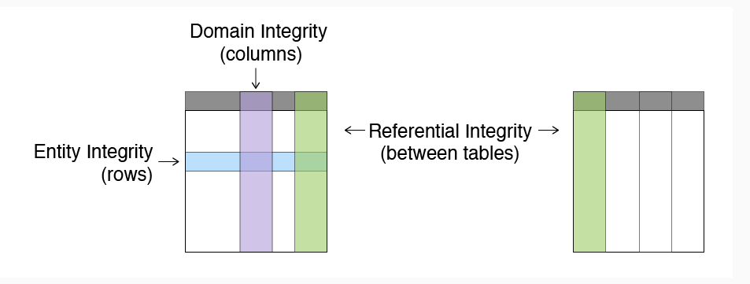
Diagramatic Representation - Constraints
Constraints in Relational DB

Slide 8
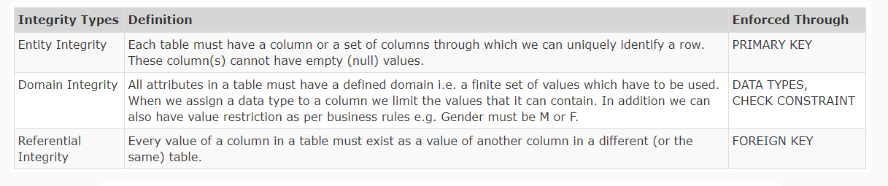
Methods to achieve Constraints
Constraints in Relational DB

Slide 9
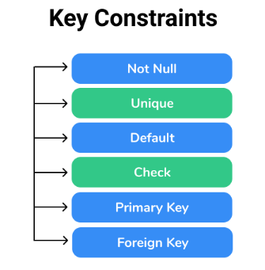
Key Constraint
Constraints in Relational DB

Slide 10
NOT NULL - Key Constraint
NOT NULL : Ensures that the specified column doesn’t contain a NULL value.
Null represents a record where data may be missing or data for that record may be optional.
Once not null is applied to a particular column, you cannot enter null values to that column and restricted to maintain only some proper value other than null.
A not-null constraint cannot be applied at table level.
Constraints in Relational DB

Slide 11
NOT NULL - Key Constraint
CREATE TABLE STUDENT(ROLLNO INT NOT NULL,
NAME VARCHAR(25) NOT NULL,
ADDRESS VARCHAR(100),
PHONE BIGINT NOT NULL,
AGE INT NOT NULL,
DEPT VARCHAR(10)
);
ROLL_NO | NAME | ADDRESS | PHONE | AGE | DEPTNAME
1 | RAM | DELHI | 9455123451 | 18 | CSE
2 | RAMESH | GURGAON | 9652431543 | 18 | ECE
3 | SUJIT | CHENNAI | 9156253131 | 20 | CSE
4 | SURESH | HYDERABAD | 9442951245 | 18 | IT
5 | SUJIT | MUMBAI | 9994464211 | 18 | IT
MY SQL
ALTER TABLE STUDENT MODIFY ROLLNO INT NOT NULL;
Null Values not allowed
Null Values not allowed
MS SQL
Null Values allowed
ALTER TABLE STUDENT ALTER COLUMN ROLLNO INT NOT NULL;
Constraints in Relational DB

Slide 12
Candidate Key - Key Constraint
A Candidate Key is a minimal set of columns/attributes that can be used to uniquely identify a single row/tuple in a relation.
Candidate Key 1
Candidate Key 2
Minimal and Uniquely Identifies a tuple
ROLL_NO | NAME | ADDRESS | PHONE | AGE | DEPTNAME
1 | RAM | DELHI | 9455123451 | 18 | CSE
2 | RAMESH | GURGAON | 9652431543 | 18 | ECE
3 | SUJIT | CHENNAI | 9156253131 | 20 | CSE
4 | SURESH | HYDERABAD | 9442951245 | 18 | IT
5 | SUJIT | MUMBAI | 9994464211 | 18 | IT
Constraints in Relational DB

Slide 13
Unique - Key Constraint
Unique Key : Each column values should be distinct / unique.
Sometimes we need to maintain only unique data in the column of a database table, this is possible by using a unique constraint.
Unique constraint ensures that all values in a column are unique .
Unique constraint allows null values.
Constraints in Relational DB

Slide 14
Unique - Key Constraint
No Values should be repeated
CREATE TABLE STUDENT(ROLLNO INT NOT NULL,
NAME VARCHAR(25) NOT NULL,
ADDRESS VARCHAR(100),
PHONE BIGINT NOT NULL UNIQUE,
AGE INT NOT NULL,
DEPT VARCHAR(10)
);
ROLL_NO | NAME | ADDRESS | PHONE | AGE | DEPTNAME
1 | RAM | DELHI | 9455123451 | 18 | CSE
2 | RAMESH | GURGAON | 9652431543 | 18 | ECE
3 | SUJIT | CHENNAI | 9156253131 | 20 | CSE
4 | SURESH | HYDERABAD | 9442951245 | 18 | IT
5 | SUJIT | MUMBAI | 9994464211 | 18 | IT
ALTER TABLE STUDENT ADD CONSTRAINT uk_student UNIQUE(PHONE) ;
Null Values not allowed
Null Values not allowed
Null Values allowed
Constraints in Relational DB

Slide 15
Primary Key - Key Constraint
A Primary Key is a constraint in a table which uniquely identifies each row or record in a database table.
Primary key column doesn’t allow NULL values in it.
PRIMARY KEY = NOT NULL + UNIQUE KEY
Table can have only one primary key. (But that primary key can contain multiple field ).
When two or more columns together identify the unique row then it's referred to as Composite Primary Key.
Constraints in Relational DB

Slide 16
Primary - Key Constraint
No Values should be repeated and No NULL Values
CREATE TABLE STUDENT(ROLLNO INT NOT NULL,
NAME VARCHAR(25) NOT NULL,
ADDRESS VARCHAR(100),
PHONE BIGINT NOT NULL UNIQUE,
AGE INT NOT NULL,
DEPT VARCHAR(10)
);
ROLL_NO | NAME | ADDRESS | PHONE | AGE | DEPTNAME
1 | RAM | DELHI | 9455123451 | 18 | CSE
2 | RAMESH | GURGAON | 9652431543 | 18 | ECE
3 | SUJIT | CHENNAI | 9156253131 | 20 | CSE
4 | SURESH | HYDERABAD | 9442951245 | 18 | IT
5 | SUJIT | MUMBAI | 9994464211 | 18 | IT
ALTER TABLE STUDENT ADD CONSTRAINT pk_student PRIMARY
KEY(PHONE);
Null Values not allowed
Null Values not allowed
Null Values allowed
Constraints in Relational DB

Slide 17
Foreign Key - Key Constraint
The Foreign key constraint is a column or list of columns which points to the primary key column of another table.
The main purpose of the foreign key is only those values are allowed in the child table that will match to the primary key column of another table.
Constraints in Relational DB

Slide 18
Foreign Key - Key Constraint
STUDENT (Child Table)
CREATE TABLE STUDENT (
ROLL_NO INT NOT NULL, NAME VARCHAR (20) NOT NULL, ADDRESS CHAR (25) ,
PHONE INT,
AGE INT NOT NULL, DEPTNAME VARCHAR(20) ,
PRIMARY KEY (ROLL_NO,PHONE),
CONSTRAINT FK_STUDENT FOREIGN KEY (DEPTNAME) REFERENCES DEPARTMENT (DEPTNAME )
REFERENCES );
ROLL_NO | NAME | ADDRESS | PHONE | AGE | DEPTNAME
1 | RAM | DELHI | 9455123451 | 18 | CSE
2 | RAMESH | GURGAON | 9652431543 | 18 | ECE
3 | SUJIT | CHENNAI | 9156253131 | 20 | CSE
4 | SURESH | HYDERABAD | 9442951245 | 18 | IT
DEPARTMENT (Parent Table)
DEPTID | DEPTNAME | HOD | PHONE
1 | CSE | RAJA | 9442876561
2 | ECE | AGALYA | 7896784523
3 | EEE | PRAVEEN | 9876423151
4 | IT | PREETAM | 9789654321
Constraints in Relational DB

Slide 19
CHECK- Key Constraint
The CHECK constraint is used to limit the value range that can be placed in a column.
If you define a check constraint on a column it will allow only certain values for this column.
If you define a check constraint on a table it can limit the values in certain columns based on values in other columns in the row.
Constraints in Relational DB

Slide 20
CHECK - Key Constraint
CREATE TABLE STUDENT(ROLLNO INT NOT NULL,
NAME VARCHAR(25) NOT NULL,
ADDRESS VARCHAR(100),
PHONE BIGINT NOT NULL UNIQUE,
AGE INT CHECK (Age>=18),
DEPT VARCHAR(10)
);
ROLL_NO | NAME | ADDRESS | PHONE | AGE | DEPTNAME
1 | RAM | DELHI | 9455123451 | 18 | CSE
2 | RAMESH | GURGAON | 9652431543 | 18 | ECE
3 | SUJIT | CHENNAI | 9156253131 | 20 | CSE
4 | SURESH | HYDERABAD | 9442951245 | 18 | IT
5 | SUJIT | MUMBAI | 9994464211 | 18 | IT
the values cannot be less than 18.
While Inserting values in the Age column, the values cannot be less than 18.
Constraints in Relational DB

Slide 21
Default - Key Constraint
DEFAULT: provides a default data to a column if none is specified.
When a column is specified as default with some value then all the rows will use the same value i.e each and every time while entering the data we need not enter that value.
But default column value can be customized (i.e )it can be overridden when inserting a data for that row based on the requirement.
Constraints in Relational DB

Slide 22
DEFAULT- Key Constraint
CREATE TABLE STUDENT ( ROLL_NO INT NOT NULL, NAME VARCHAR (20) NOT NULL, ADDRESS CHAR (25) DEFAULT CHENNAI,
PHONE INT ,
AGE INT CHECK (Age>=18), DEPTNAME VARCHAR(20) );
ROLL_NO | NAME | ADDRESS | PHONE | AGE | DEPTNAME
1 | RAM | CHENNAI | 9455123451 | 18 | CSE
2 | RAMESH | CHENNAI | 9652431543 | 18 | ECE
3 | SUJIT | CHENNAI | 9156253131 | 20 | CSE
4 | SURESH | CHENNAI | 9442951245 | 18 | IT
5 | SUJIT | CHENNAI | 9994464211 | 18 | IT
Rows With Default Values “CHENNAI”.
whenever you insert a new row each time you need not enter a value for this default column.
Entering a column value for a default column is optional and if you don’t enter the same value is considered that is used in the default clause
Constraints in Relational DB

Slide 23
Demo
Constraints in Relational DB

Slide 24
Quiz
1. The relationship between the two relations is created using __________
Candidate key
Primary key
Foreign key
Check constraint
2. Which of the following statement(s) is/are FALSE about Primary key? [ Choose any TWO]
Primary key uniquely identifies a row
There can be more than one Primary key for a table
Primary key column(s) in one table can be referenced by Foreign key column(s) in another table
Columns with string(Char/Varchar2) data types cannot be made Primary key because they are large
3. The entity Customer(CustId, CustName,Email,ContactNo,Adress) has three Candidate keys: a) CustId b) Email and c) ContactNo. Suggest the best Primary key for this entity.
CustId
Email
ContactNo
CustId and ContactNo
Constraints in Relational DB

Slide 25
Quiz
4. Identify the Primary key for the RechargePayment table
Operator
Plans
RechargeId
Operator, Plans
5. Identify the Foreign key for the table RechargePayment.
Operator
Plans
RechargeId, Operator
Operator, Plans
6. Which requirements can be implemented using a referential integrity constraint?
Customer must have a name
Age of the customer must be greater than 18
Customer information must be known before anything is sold to him/her
Two customers cannot have same mobile number
Constraints in Relational DB

Slide 26
Quiz
7. Which of the following statements are TRUE? [Choose any TWO]
A column with a CHECK constraint does not allow NULL values
A Unique constraint allows multiple rows to have NULL value
A PRIMARY KEY allows a single row to contain NULL value
Referential integrity constraint allows NULL value
8. Which requirements can be implemented using a CHECK constraint? [Choose any TWO]
Customer must have a name
Age of the customer must be greater than 21
Customer must have a residence in an Asian Country
Two customers cannot have same email id
9. Which is the constraint that can be defined only at the column level?
UNIQUE
NOT NULL
DEFAULT
PRIMARY KEY
Constraints in Relational DB

Slide 27
Quiz
10. Which one of the following attribute can be taken as a primary key?
Name
Street
Id
Department
11. A _____ is a property of the entire relation, rather than of the individual tuples in which each tuple is unique.
Rows
Key
Attribute
Fields
12. Identify the Candidate key for the RechargePlan table.
Operator
Plans
Operator, RechargeType
Operator, Plans
Constraints in Relational DB

